Slide 1
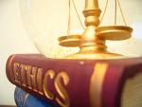
Business ethics

Slide 2
MEANING
Ethics is a set of rules that define right and wrong conduct.
Business ethics can be defined as written and unwritten codes of principles and values that govern decisions and actions within a company. In the business world, the organization’s culture sets standards for determining the difference between good and bad decision making and behavior.

Slide 3
Long termism in business
Issues of corporate ethics have taken the form of short-termism vs. long-termism
If businesses are focused on long term stability and growth, they are ethical:
  Short term strategies, aimed at earning per share for the year in question, compromise on longer interests
Warren Buffet has often stressed on long term strategies
Investigations into Fannie Mae suggested that the entire senior management was intensively focused on earnings guidance
Capital market orientation of companies force them to be tempted by short term targets:
  Increasingly, the entire system of how companies are evaluated by analysts, investors and stock markets leads to a short term approach
  McKinsey survey [March 2006] shows that companies are focused on short term strategies due to market pressures

Slide 4
3 Models of Management Ethics
Three Types Of Management Ethics
Moral
Amoral
Immoral

Slide 5
3 Models of Management Ethics
Moral Management—Conforms to high standards of ethical behavior.
Immoral Management—A style devoid of ethical principles and active opposition to what is ethical.
3. Amoral Management—
  Intentional - does not consider ethical factors
  Unintentional - casual or careless about ethical considerations in business

Slide 6
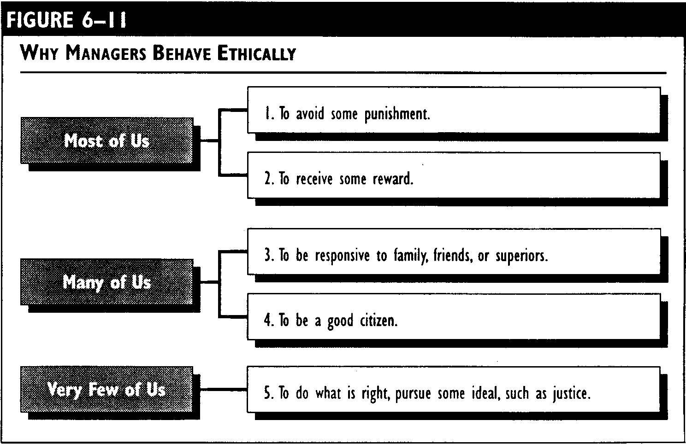
Developing Moral Judgment
6-23

Slide 7
Making Ethical Judgments
Behavior or act that has been committed
Prevailing norms of acceptability
compared with
Value judgments and perceptions of the observer

Slide 8
Stakeholder Versus Shareholder
Shareholder Perspective
Stakeholder Perspective
Those who approach ethical decision making from a shareholder perspective focus on making decisions that are in the owners' best interest. Decisions are guided by a need to maximize return on investment for the organization’s shareholders.
Stakeholders may include: employees, suppliers, customers, competitors, government agencies, the news media, community residents and others. The idea behind stakeholder based ethical decision making is to make sound business decisions that work for the good of all affected parties

Slide 9
What is Ethical Behavior?
. In many situations lines between right and wrong are blurred. Such situations can lead to ethical dilemmas.
When faced with ethical dilemmas, it’s important to consider outcomes of the decision-making process. One way of dealing with ethical dilemmas is by using the four way test to evaluate decisions. This test involves asking four questions:
Is my decision a truthful one?
Is my decision fair to everyone affected?
Will it build goodwill for the organization?
Is the decision beneficial to all parties who have a vested interest in the outcome?

Slide 10
WHO IS RESPONSIBLE FOR CREATING ETHICS IN AN ORGANIZATION ?
A company’s managers play an important role in establishing its ethical tone. If managers behave as if the only thing that matters is profit, employees are likely to act in a like manner. A company’s leaders are responsible for setting standards for what is and is not acceptable employee behavior. It’s vital for managers to play an active role in creating a working environment where employees are encouraged and rewarded for acting in an ethical manner.

Slide 11
Other Factors Impacting Organizational Ethics
Corporate culture
Existence and application of a written code of ethics
Formal and informal policies and rules
Norms for acceptable behavior
Financial reward system
System for recognizing accomplishment
Company attitude toward employees
How employees are selected for promotions
Hiring practices
Applications of legal behavior
Degree to which professionalism is emphasized
The company’s decision making processes
Behaviors and attitudes of the organization’s leaders

Slide 12
7 Principles of Admirable Business Ethics
1. Be Trustful
2. Keep An Open Mind
3. Meet Obligations
4. Have Clear Documents
5. Become Community Involved
6. Maintain Accounting Control
7. Be Respectful

Slide 13
Overview of issues in business ethics
Corporate social responsibility
fiduciary responsibility, stakeholder concept v. shareholder concept
industrial espionage.

Slide 14
General business ethics
Ethics of human resource management
Ethics of sales and marketing
Ethics of production
Ethics of intellectual property, knowledge and skills

Slide 15
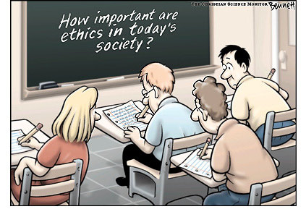
IMPORTANCE OF ETHICS

Slide 16
Public expects business to exhibit high levels of ethical performance and social responsibility.
Encouraging business firms and their employees to behave ethically is to prevent harm to society.
Promoting ethical behavior is to protect business from abuse by unethical employees or unethical competitors.
High ethical performance also protects the individuals who work in business.
IMPORTANCE OF BUSINESS ETHICS

Slide 17
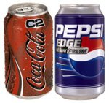
Coke & Pepsi in India
Today, more from the world of product safety. This time the story is about Coke and Pepsi, and allegations that the versions of their products manufactured in India contain unacceptably high levels of pesticides.
world’s biggest brand names, known for wooing customers around the world, are facing a credibility crisis in one of their crucial emerging markets.

Slide 18
RELIGIOUS VIEWS ON BUSINESS ETHICS

Slide 19
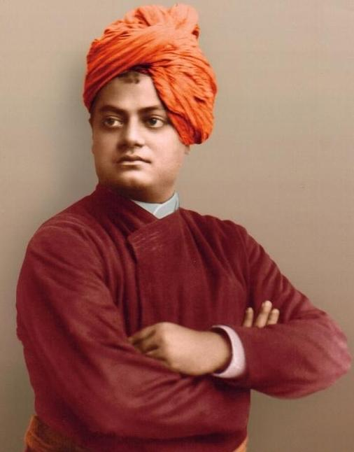
SWAMI VIVEKANAND VIEWS ON ETHICS
THE BASIS OF INDIAN SUBJECTIVITY LIES IN THE BELIEF OF GOD.
HE SUGGESTED THE FUNDAMENTAL LAW OF ETHICS
“DON’T INJURE OTHERS, LOVE EVERYONE AS YOUR OWNSELF UNIVERSE IS ONE”

Slide 20
In order to win the game, you need to plan. To plan information is imperative. Get it through legal & ethical means. In life and business, ethical standard must be set,
ETHICAL STANDARD MUST BE SET,
ETHICAL STANDARD MUST BE MET.

Slide 21
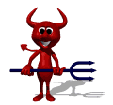
Ethics are important not only in business but in all aspects of life because it is an essential part of the foundation on which of a civilized society is build. A business or society that lacks ethical principles is bound to fail sooner or later.
CONCLUSION

