Slide 1
QUEUE

Slide 2
Queue
Stores a set of elements in a particular order
Stack principle: FIRST IN FIRST OUT
= FIFO
It means: the first element inserted is the first one to be removed
Example
The first one in line is the first one to be served
cinemark

Slide 3
Queue Applications
Real life examples
  Waiting in line
  Waiting on hold for tech support
Applications related to Computer Science
  Threads
  Job scheduling (e.g. Round-Robin algorithm for CPU allocation)

Slide 4
First In First Out
A
B
A
C
B
A
D
C
B
A
rear
front
D
C
B
rear
front
rear
front
rear
front
rear
front

Slide 5
Applications: Job Scheduling

Slide 6
objects: a finite ordered list with zero or more elements. methods: for all queue ∈ Queue, item ∈ element, max_ queue_ size ∈ positive integer
Queue createQ(max_queue_size) ::= create an empty queue whose maximum size is max_queue_size
Boolean isFullQ(queue, max_queue_size) ::= if(number of elements in queue == max_queue_size) return TRUE else return FALSE
Queue Enqueue(queue, item) ::= if (IsFullQ(queue)) queue_full else insert item at rear of queue and return queue
Queue ADT

Slide 7
Boolean isEmptyQ(queue) ::= if (queue ==CreateQ(max_queue_size)) return TRUE else return FALSE
Element dequeue(queue) ::= if (IsEmptyQ(queue)) return else remove and return the item at front of queue.
Queue ADT (cont’d)

Slide 8
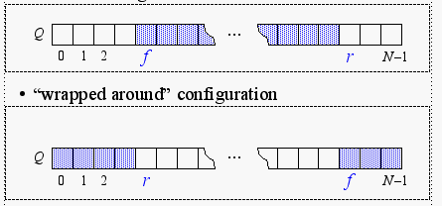
Array-based Queue Implementation
As with the array-based stack implementation, the array is of fixed size
  A queue of maximum N elements
Slightly more complicated
  Need to maintain track of both front and rear
Implementation 1
Implementation 2

Slide 9
Queue createQ(max_queue_size) ::=
# define MAX_QUEUE_SIZE 100/* Maximum queue size */ typedef struct { int key;
/* other fields */
} element; element queue[MAX_QUEUE_SIZE]; int rear = -1; int front = -1;
Boolean isEmpty(queue) ::= front == rear
Boolean isFullQ(queue) ::= rear == MAX_QUEUE_SIZE-1
Implementation 1:
createQ, isEmptyQ, isFullQ

Slide 10
void enqueue(int *rear, element item)
{
/* add an item to the queue */ if (*rear == MAX_QUEUE_SIZE_1) { queue_full( ); return;
} queue [++*rear] = item;
}
Implementation 1:
enqueue

Slide 11
element dequeue(int *front, int rear)
{
/* remove element at the front of the queue */ if ( *front == rear) return queue_empty( ); /* return an error key */ return queue [++ *front];
}
Implementation 1:
dequeue

Slide 12
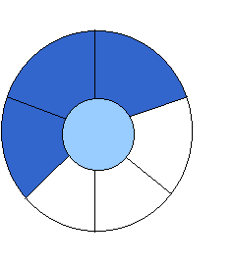
Implementation 2:
Wrapped Configuration
EMPTY QUEUE
[2]
[3] [2] [3]
J2
J3
[1] [4] [1] [4]
J1
[0] [5] [0] [5]
front = 0 front = 0
rear = 0 rear = 3
Can be seen as a circular queue

Slide 13
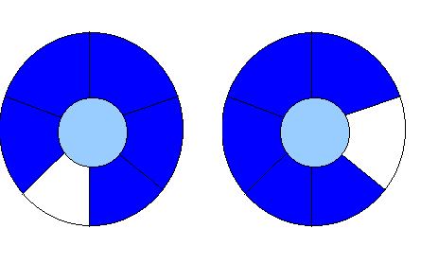
Leave one empty space when queue is full
Why?
FULL QUEUE FULL QUEUE
[2] [3] [2] [3]
J2 J3
J8 J9
J7
[1] [4][1] [4]
J1 J4
J5
J6 J5
[0] [5] [0] [5]
front =0
rear = 5
front =4
rear =3
How to test when queue is empty?
How to test when queue is full?

Slide 14
void enqueue(int front, int *rear, element item)
{
/* add an item to the queue */
*rear = (*rear +1) % MAX_QUEUE_SIZE; if (front == *rear) /* reset rear and print error */ return;
} queue[*rear] = item;
}
Enqueue in a Circular Queue

Slide 15
element dequeue(int* front, int rear)
{ element item;
/* remove front element from the queue and put it in item */ if (*front == rear) return queue_empty( );
/* queue_empty returns an error key */
*front = (*front+1) % MAX_QUEUE_SIZE; return queue[*front];
}
Dequeue from Circular Queue

Slide 16
List-based Queue Implementation: Enqueue
void enqueue(pnode &front, pnode rear, element item)
{ /* add an element to the rear of the queue */
pnode temp =
(pnode) malloc(sizeof (queue));
if (IS_FULL(temp)) {
fprintf(stderr, “ The memory is full\n”);
exit(1);
}
temp->item = item;
temp->next= NULL;
if (front) { (rear) -> next= temp;}
else front = temp;
rear = temp; }

Slide 17
Dequeue
element dequeue(pnode &front) {
/* delete an element from the queue */
pnode temp = front;
element item;
if (IS_EMPTY(front)) {
fprintf(stderr, “The queue is empty\n”);
exit(1);
}
item = temp->item;
front = temp->next;
free(temp);
return item;
}

Slide 18
Algorithm Analysis
enqueue O(?)
dequeue O(?)
size O(?)
isEmpty O(?)
isFull O(?)
What if I want the first element to be always at Q[0] ?

