Slide 1
INTRODUCTION TO
DBMS
-

Slide 2
1.1 Basic terminology
Database: A collection of related data
Data: Known facts that can be recorded and have an implicit meaning
Mini-world: Some part of the real world about which data is stored in a database. For example, student grades and transcripts at a university
Database System: The DBMS software together with the data itself. Sometimes, the applications are also included

Slide 3
1.2 Example of a Database
Mini-world for the example: Part of a UNIVERSITY environment.
Some mini-world entities:
  STUDENTs
  COURSEs
  SECTIONs (of COURSEs)
  (academic) DEPARTMENTs
  INSTRUCTORs

Slide 4
Some mini-world relationships:
  SECTIONs are of specific COURSEs
  STUDENTs take SECTIONs
  COURSEs have prerequisite COURSEs
  INSTRUCTORs teach SECTIONs
  COURSEs are offered by DEPARTMENTs
  STUDENTs major in DEPARTMENTs

Slide 5

A database management system (DBMS) is a collection of programs that enables users to create and maintain a database
The DBMS is hence a general-purpose software system that facilitates the processes of defining, constructing, and manipulating databases for various applications

Slide 6
Defining a database involves specifying the data types, structures, and constraints for the data to be stored in the database
Constructing the database is the process of storing the data itself on some storage medium that is controlled by the DBMS
Manipulating a database includes such functions as querying the database to retrieve specific data, updating the database to reflect changes in the mini world, and generating reports from the data.

Slide 7
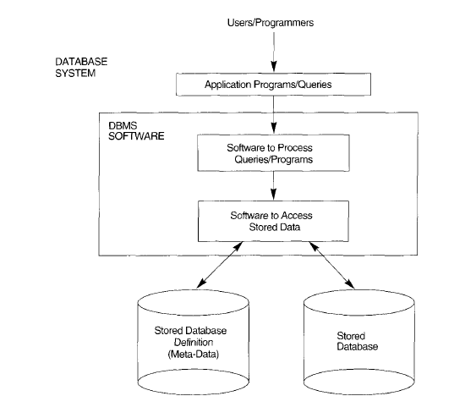
Fig: Database System environment

Slide 8
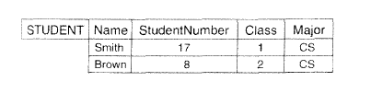
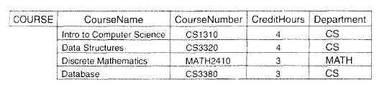

Slide 9


Slide 10
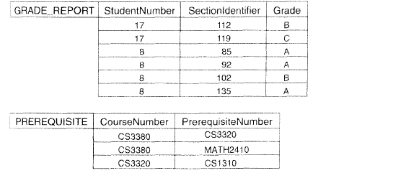

Slide 11
1.3 CHARACTERISTICS OF
THE DATABASE APPROACH
In traditional file processing, each user defines and implements the files needed for a specific software application as part of programming the application
Redundancy in defining and storing data results in wasted storage space and in redundant efforts to maintain common data up to date
In the database approach, a single repository of data is maintained that is defined once and then is accessed by various users.

Slide 12
The main characteristics of the database approach versus the file-processing approach are the following:
Self-describing nature of a database system
• Insulation between programs and data, and data abstraction
• Support of multiple views of the data
• Sharing of data and multiuser transaction processing

Slide 13

1. Self-describing nature of a database system
The database system contains not only the database itself but also a complete definition or description of the database structure and constraints
This definition is stored in the DBMS catalog, which contains information such as the structure of each file, the type and storage format of each data item, and various constraints on the data

Slide 14
Continued….
The information stored in the catalog is called meta-data, and it describes the structure of the primary database
A general-purpose DBMS software package is not written for a specific database application, and hence it must refer to the catalog to know the structure of the files in a specific database, such as the type and format of data it will access

Slide 15
Continued…
In traditional file processing, data definition is typically part of the application programs themselves
Hence, these programs are constrained to work with only one specific database, whose structure is declared in the application programs
Whereas file-processing software can access only specific databases, DBMS software can access diverse databases by extracting the database definitions from the catalog and then using these definitions

Slide 16
2.Insulation between Programs and Data, and
Data Abstraction
In traditional file processing, the structure of data files is embedded in the application programs, so any changes to the structure of a file may require changing all programs that access this file
By contrast, DBMS access programs do not require such changes in most cases
The structure of data files is stored in the DBMS catalog separately from the access programs
We call this property as program-data independence.

Slide 17
Continued….
User application programs can operate on the data by invoking operations through their names and arguments, regardless of how the operations are implemented
This may be termed program-operation independence
The characteristic that allows program-data independence and program-operation independence is called data abstraction
A DBMS provides users with a conceptual representation of data

Slide 18
Continued…
A data model is a type of data abstraction that is used to provide the conceptual representation
The data model uses logical concepts, such as objects, their properties, and their interrelationships, that may be easier for most users to understand than computer storage concepts.
Hence, the data model hides storage and implementation details that are not of interest to most database users

Slide 19
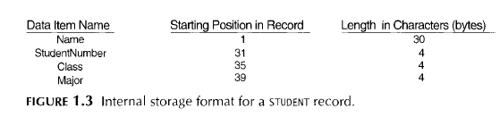
Continued…

Slide 20
Continued…
In the database approach, the detailed structure and organization of each file are stored in the catalog
Database users and application programs refer to the conceptual representation of the files
And the DBMS extracts the details of file storage from the catalog when these are needed by the DBMS file access modules

Slide 21

3. Support of Multiple Views of the Data
A database typically has many users, each of whom may require a different perspective or view of the database
A view may be a subset of the database or it may contain virtual data that is derived from the database files but is not explicitly stored
Some users may not need to be aware of whether the data they refer to is stored or derived
A multiuser DBMS whose users have a variety of distinct applications must provide facilities for defining multiple views

Slide 22
4. Sharing of Data and Multiuser Transaction Processing
A multiuser DBMS, must allow multiple users to access the database at the same time
This is essential if data for multiple applications is to be integrated and maintained in a single database
The DBMS must include concurrency control software
These types of applications are generally called online transaction processing (OLTP) applications
A fundamental role of multiuser DBMS software is to ensure that concurrent transactions operate correctly.

Slide 23
Continued…
A transaction is an executing program or process that includes one or more database accesses, such as reading or updating of database records
The isolation property ensures that each transaction appears to execute in isolation from other transactions, even though hundreds of transactions may be executing concurrently
The atomicity property ensures that either all the database operations in a transaction are executed or none are

Slide 24
1.4 ACTORS ON THE SCENE
The people whose jobs involve the day-to-day use of a large database are called as "actors on the scene.“
    Database Administrators
    Database Designers
    End Users
    System Analysts and Application Programmers (Software Engineers)

Slide 25
    1.4.1. Database Administrators
In any organization where many persons use the same resources, there is a need for a chief administrator to oversee and manage these resources
In a database environment, the primary resource is the database itself, and the secondary resource is the DBMS and related software
Administering these resources is the responsibility of the database administrator (DBA)

Slide 26
The DBA is responsible for authorizing access to the database, for coordinating and monitoring its use, and for acquiring software and hardware resources as needed
The DBA is accountable for problems such as breach of security or poor system response time
In large organizations, the DBA is assisted by a staff that helps carry out these functions

Slide 27
1.4.2. Database Designers
Database designers are responsible for identifying the data to be stored in the database
They have to choose appropriate structures to represent and store this data
These tasks are mostly undertaken before the database is actually implemented and populated with data
It is the responsibility of database designers to communicate with all prospective database users in order to understand their requirements, and to come up with a design that meets these requirements.

Slide 28
Continued…
In many cases, the designers are on the staff of the DBA and may be assigned other staff responsibilities after the database design is completed
Database designers typically interact with each potential group of users and develop views of the database that meet the data and processing requirements of these groups
Each view is then analyzed and integrated with the views of other user groups
The final database design must be capable of supporting the requirements of all user groups

Slide 29
1.4.3. End Users
End users are the people whose jobs require access to the database for querying, updating, and generating reports; the database primarily exists for their use
There are several categories of end users:
1. Casual end users : They occasionally access the database, but they may need different information each time
They use a sophisticated database query language to specify their requests and are typically middle- or high-level managers or other occasional browsers.

Slide 30
2. Naive or parametric end users: make up a sizable portion of database end users.
Their main job function revolves around constantly querying and updating the database, using standard types of queries and updates-called canned transactions-that have been carefully programmed and tested
The tasks that such users perform are varied
Bank tellers check account balances and post withdrawals and deposits
Reservation clerks fur airlines, hotels, and car rental companies check availability for a given request and make reservations..

Slide 31
3. Sophisticated end users: include engineers, scientists, business analysts, and others who thoroughly familiarize themselves with the facilities of the DBMS so as to implement their applications to meet their complex requirements.
4. Stand-alone users : maintain personal databases by using ready-made program packages that provide easy-to-use menu-based or graphics-based interfaces. An example is the user of a tax package that stores a variety of personal financial data for tax purposes

Slide 32
Naive end users need to learn very little about the facilities provided by the DBMS
Casual users learn only a few facilities that they may use repeatedly
Sophisticated users try to learn most of the DBMS facilities in order to achieve their complex requirements
Stand-alone users typically become very proficient in using a specific software package

Slide 33
1.4.4 System Analysts and Application Programmers
(Software Engineers)
System analysts determine the requirements of end users, especially naive and parametric end users, and develop specifications for canned transactions that meet these requirements
Application programmers implement these specifications as programs; then they test, debug, document, and maintain these canned transactions
Such analysts and programmers- commonly referred to as software engineers-should be familiar with the full range of capabilities provided by the DBMS to accomplish their tasks.

Slide 34
1.5 WORKERS BEHIND THE SCENE
Those who work to maintain the database system environment but who are not actively interested in the database itself
They include the following categories
1. DBMS system designers and implementers
2. Tool developers
3. Operators and maintenance personnel

Slide 35
1.5.1. DBMS system designers and implementers
They are persons who design and implement the DBMS modules and interfaces as a software package
A DBMS is a very complex software system that consists of many components, or modules
Including modules for implementing the catalog, processing query language, processing the interface, accessing and buffering data, controlling concurrency, and handling data recovery and security
The DBMS must interface with other system software, such as the operating system and compilers for various programming languages

Slide 36
1.5.2. Tool developers
They include persons who design and implement tools-the software packages that facilitate database system design and use and that help improve performance
Tools are optional packages that are often purchased separately
They include packages for database design, performance monitoring, natural language or graphical interfaces, prototyping, simulation, and test data generation
In many cases, independent software vendors develop and market these tools.

Slide 37
1.5.3. Operators and maintenance personnel
They are the system administration personnel who are responsible for the actual running and maintenance of the hardware and software environment for the database system
Although these categories of workers behind the scene are instrumental in making the database system available to end users, they typically do not use the database for their own purposes.

Slide 38
1.6 ADVANTAGES OF USING THE DBMS
APPROACH
These capabilities are in addition to the four main characteristics
The DBA must utilize these capabilities to accomplish a variety of objectives related to the design, administration, and use of a large multiuser database.
1 Controlling Redundancy
2 Restricting Unauthorized Access

Slide 39
1.6.3.Providing Persistent Storage for Program Objects
A complex object in c++ can be stored permanently in an object-oriented DBMS. Such an object is said to be persistent, since it survives the termination of program execution and can later be directly retrieved by another c+ + program
Traditional database systems often suffered from the so called impedance mismatch problem, since the data structures provided by the DBMS were incompatible with the programming language's data structures
Object-oriented database systems typically offer data structure compatibility with one or more object oriented programming languages

Slide 40
1.6.4 Providing Storage Structures for Efficient Query
Processing
Database systems must provide capabilities for efficiently executing queries and updates
Because the database is typically stored on disk, the DBMS must provide specialized data structures to speed up disk search for the desired records.
Auxiliary files called indexes are used for this purpose. Indexes are typically based on tree data structures or hash data structures, suitably modified for disk search
In order to process the database records needed by particular query, those records must be copied from disk to memory. Hence, the DBMS often has a buffering module that maintains parts of the database in main memory buffers
In other cases, the DBMS may use the operating system to do the buffering of disk data.

Slide 41
The query processing and optimization module of the DBMS is responsible for choosing an efficient query execution plan for each query based on the existing storage structures
The choice of which indexes to create and maintain is part of physical database design and tuning, which is one of the responsibilities of the DBA staff.

Slide 42
1.6.5 Providing Backup and Recovery
A DBMS must provide facilities for recovering from hardware or software failures
The backup and recovery subsystem of the DBMS is responsible for recovery
For example, if the computer system fails in the middle of a complex update transaction, the recovery subsystem is responsible for making sure that the database is restored to the state it was in before the transaction started executing.
Alternatively, the recovery subsystem could ensure that the transaction is resumed from the point at which it was interrupted so that its full effect is recorded in the database.

Slide 43
1.6.6 Providing Multiple User Interfaces
Because many types of users with varying levels of technical knowledge use a database, a DBMS should provide a variety of user interfaces
These include query languages for casual users, programming language interfaces for application programmers, forms and command codes for parametric users, and menu-driven interfaces and natural language interfaces for stand-alone users
Both forms-style interfaces and menu-driven interfaces are commonly known as graphical user interfaces (GU Is)
Many specialized languages and environments exist for specifying Guls
Capabilities for providing Web GUl interfaces to a database- or Web-enabling a database-are also quite common.

Slide 44

1.6.7 Representing Complex Relationships among Data
A database may include numerous varieties of data that are interrelated in many ways
A DBMS must have the capability to represent a variety of complex relationships among the data as well as to retrieve and update related data easily and efficiently

Slide 45
1.6.8 Enforcing Integrity Constraints
Most database applications have certain integrity constraints that must hold for the data
A DBMS should provide capabilities for defining and enforcing these constraints
The simplest type of integrity constraint involves specifying a data type for each data item
It is the database designers' responsibility to identify integrity constraints during database design

Slide 46
1.6.10 Additional Implications of Using the Database
Approach
Potential for Enforcing Standards
Reduced Application Development Time
Flexibility
Availability of Up-to-Date Information
Economies of Scale

Slide 47
1.7 A BRIEF HISTORY OF DATABASE APPLICATION
1.7.1 Early Database Applications Using Hierarchical and Network Systems
In many of early database applications like universities, hospitals, and banks maintained records in large organizations, there were large numbers of records of similar structure
One of the main problems with early database systems was the intermixing of conceptual relationships with the physical storage and placement of records on disk

Slide 48
Another shortcoming of early systems was that they provided only programming language interfaces
This made it time-consuming and expensive to implement new queries and transactions, since new programs had to be written, tested, and debugged
The main types of early systems were based on three main paradigms: hierarchical systems, network model based systems, and inverted file systems.

Slide 49
1.7.2 Providing Application Flexibility with Relational
Databases
Relational databases were originally proposed to separate the physical storage of data from its conceptual representation and to provide a mathematical foundation for databases
The relational data model also introduced high-level query languages that provided an alternative to programming language interfaces; hence, it was a lot quicker to write new queries.

Slide 50
Early experimental relational systems developed in the late 1970s
The commercial RDBMSs introduced in the early 1980s were quite slow, since they did not use physical storage pointers or record placement to access related data records
With the development of new storage and indexing techniques and better query processing and optimization, their performance improved

Slide 51
1.7.3 Object-Oriented Applications and the Need for
More Complex Databases
The emergence of object-oriented programming languages in the 1980s and the need to store and share complex-structured objects led to the development of object-oriented databases
Initially, they were considered a competitor to relational databases, since they provided more general data structures
They also incorporated many of the useful object oriented paradigms, such as abstract data types, encapsulation of operations, inheritance, and object identity

Slide 52
However, the complexity of the model and the lack of an early standard contributed to their limited use
They are now mainly used in specialized applications, such as engineering design, multimedia publishing, and manufacturing systems

Slide 53
1.7.4 Interchanging Data on the Web for
E-Commerce
In the 1990s, electronic commerce (e-commerce) emerged as a major application on the Web
It quickly became apparent that parts of the information on e-commerce
Web pages were often dynamically extracted data from DBMSs
A variety of techniques were developed to allow the interchange of data on the Web.

