Slide 1
Evaluation & other strategic issues
Module :V

Slide 2
meaning
Strategic Evaluation is defined as the process of determining the effectiveness of a given strategy in achieving the organizational objectives and taking corrective action wherever required.  Strategy evaluation is the final step of strategy management process.

Slide 3
Typically, the strategy evaluation process involves answering questions such as:
How much progress have we made towards our Vision?
Are our Strategic Focus Areas still relevant?
Which of our Objectives have we completed?
Which Objectives are no longer needed?
Do we have sufficient Projects to deliver incomplete Objectives?
Are our KPIs still effective for measuring progress towards our Objectives?
Where we fell short of our targets, why did this happen?

Slide 4
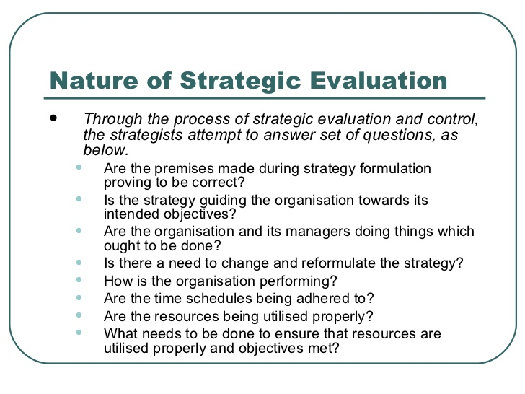

Slide 5
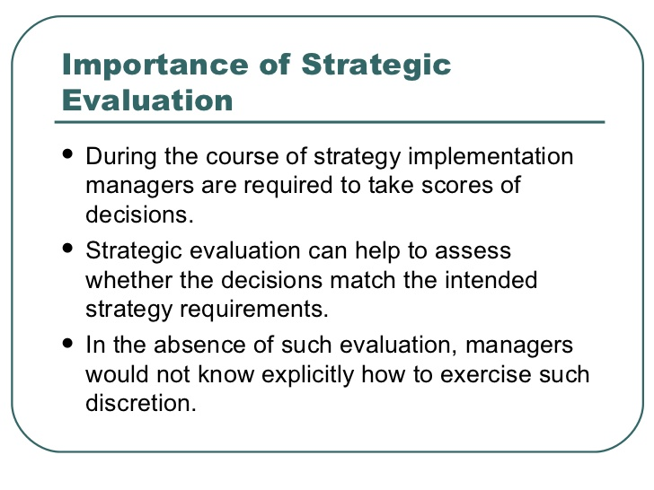

Slide 6
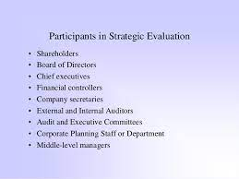

Slide 7
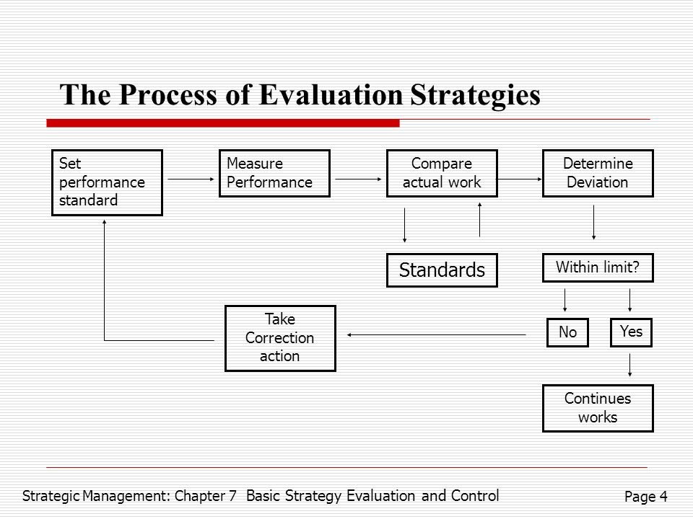

Slide 8
'Strategy evaluation' is the process through which the strategists know the extent to which a strategy is able to achieve its objectives.
The process of strategy evaluation consists of following steps:
Fixing Benchmark of Performance: ...
Measurement of Performance: ...
Analyzing Variance: ...
Taking Corrective Action:

Slide 9
Fixing benchmark of performance
While fixing the benchmark, strategists encounter questions such as - what benchmarks to set, how to set them and how to express them. In order to determine the benchmark performance to be set, it is essential to discover the special requirements for performing the main task. The performance indicator that best identify and express the special requirements might then be determined to be used for evaluation. The organization can use both quantitative and qualitative criteria for comprehensive assessment of performance. Quantitative criteria includes determination of net profit, ROI, earning per share, cost of production, rate of employee turnover etc. Among the Qualitative factors are subjective evaluation of factors such as - skills and competencies, risk taking potential, flexibility etc.

Slide 10
Measurement of performance -
The standard performance is a bench mark with which the actual performance is to be compared. The reporting and communication system help in measuring the performance. If appropriate means are available for measuring the performance and if the standards are set in the right manner, strategy evaluation becomes easier. But various factors such as managers contribution are difficult to measure. Similarly divisional performance is sometimes difficult to measure as compared to individual performance. Thus, variable objectives must be created against which measurement of performance can be done. The measurement must be done at right time else evaluation will not meet its purpose. For measuring the performance, financial statements like - balance sheet, profit and loss account must be prepared on an annual basis.

Slide 11
Analyzing Variance
While measuring the actual performance and comparing it with standard performance there may be variances which must be analyzed. The strategists must mention the degree of tolerance limits between which the variance between actual and standard performance may be accepted. The positive deviation indicates a better performance but it is quite unusual exceeding the target always. The negative deviation is an issue of concern because it indicates a shortfall in performance. Thus in this case the strategists must discover the causes of deviation and must take corrective action to overcome it.

Slide 12
Taking Corrective Action -
Once the deviation in performance is identified, it is essential to plan for a corrective action. If the performance is consistently less than the desired performance, the strategists must carry a detailed analysis of the factors responsible for such performance. If the strategists discover that the organizational potential does not match with the performance requirements, then the standards must be lowered. Another rare and drastic corrective action is reformulating the strategy which requires going back to the process of strategic management, reframing of plans according to new resource allocation trend and consequent means going to the beginning point of strategic management process.

Slide 13
strategic information system

Slide 14
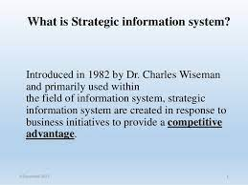

Slide 15
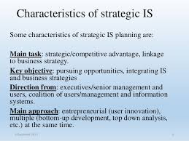

Slide 16
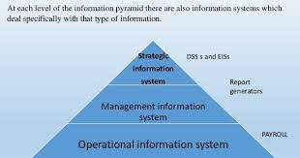

Slide 17
.
strategic issues in small business
And
non profit organization

Slide 18
What is a Strategic Issue?
A Strategic Issue is, first of all, an issue - an unresolved question needing a decision or waiting for some clarifying future event. Secondly, it is strategic and has major impact on the course and direction of the business.

Slide 19
Non-for-Profit
Non-for-Profit (NFP): An organization that provides some service or good with no intention of earning a profit. NFP includes Private nonprofit corporations (such as hospitals, institutes, private colleges, and organized charities) as well as Public governmental units/agencies (such as welfare departments, prisons, and state universities)

