Slide 1
Module :3
Strategic analysis & strategic Planning

Slide 2
strategic analysis and choice
Strategic choice is one of the critical aspects in the organization. Once the strategy is selected firm makes all the arrangement to implement it. The resources are gathered for its implementation. But if the strategy itself is defective then organization has to pay for it hence strategy choice becomes one of the important decision areas. When the right strategy is chosen its give many benefits to the organization like:

Slide 3
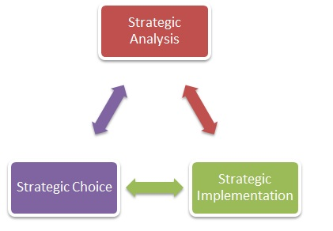

Slide 4
Steps in strategic analysis and choice
Focusing on strategic alternatives
Analyzing Strategic Alternatives
Evaluating the Strategic Alternatives
Choosing the most appropriate Strategic Alternatives

Slide 5
TOOLS AND TECHNIQUES FOR STRATEGIC ANALYSIS
SWOT ANALYSIS
PEST/ PESTEL Analysis
Porter’s five force analysis
Value Chain Analysis
BGC matrix
Portfolio analysis
Situational analysis
Michael porters Five force model

Slide 6
SWOT ANALYSIS
SWOT Analysis is a widely used tool that helps in understanding the strengths, weaknesses, opportunities and threats involved in a business activity. It is one of the simple yet effective analysis tools.
It begins by establishing the project or business activity goal and then identifying the internal and external elements that are critical to accomplishing that goal. The organization’s strengths and weaknesses are usually internal and the opportunities and threats are external.

Slide 7
Strengths: Strengths take into consideration the following type of aspects: What does your organisation do better than others? What are your unique selling points? What do your competitors and customers in your market perceive as your strengths? What is your organisation's competitive edge? | Weaknesses: Weaknesses take into consideration the following type of aspects: What do other organisations do better than you? What elements of your business add little or no value? What do competitors and customers in your market perceive as your weakness?
Opportunities: Opportunities take into consideration the following type of aspects: What political, economic, social-cultural, or technology (PEST) changes are taking place that could be favourable to you? Where are there currently gaps in the market or unfulfilled demand? What new innovation could your organisation bring to the market? | Threats: Threats take into consideration the following type of aspects: What political, economic, social-cultural, or technology (PEST) changes are taking place that could be unfavourable to you? What restraints do you face? What is your competition doing that could negatively impact you?

Slide 8
PEST/ PESTEL Analysis:
The PEST analysis is an evaluation of an organization's external macro-environment. It is a useful tool for comprehending an organization's political, economic, socio-cultural, and technological context.
The PESTEL analysis includes the environmental and legal factors as well. It can be used to assess market growth or decrease, as well as a company's position, potential, and direction. The PESTEL analysis takes into consideration the following factors:

Slide 9
Political factors: This includes government policy, political stability, corruption, foreign trade policy, tax policy, labour law, trade restrictions, etc. | Economic factors: These include economic growth, exchange rates, interest rates, inflation rates, disposable income, unemployment rates, etc.
Social factors: These include population growth rate, age distribution, career attitudes, safety emphasis, health consciousness, lifestyle attitudes, cultural barriers, etc. | Technology factors: These include technology initiatives, level of innovation, automation, R&D activity, technological change, technological awareness, etc.
Environmental factors: These include weather, climate, environmental policies, climate change, pressure from NGOs, etc. | Legal factors: These include laws such as discrimination laws, antitrust laws, employment laws, consumer protection laws, copyright and patent laws, health and safety laws, etc.

Slide 10
Porter’s five force analysis:
Michael E. Porter of Harvard Business School established Porter's five forces of competitive position analysis in 1979 as a basic framework for examining and evaluating a business organization's competitive strength and position.
Porter's five forces assists a firm in figuring out who has the most power in a business issue. This is valuable for determining the strength of an organization's present competitive position as well as the strength of a position that an organisation might want to pursue.
Strategic analysts often use Porter’s five forces to understand whether new products or services are potentially profitable. By understanding where power lies, the theory can also be used to identify areas of strength, to improve weaknesses and to avoid mistakes.

Slide 11
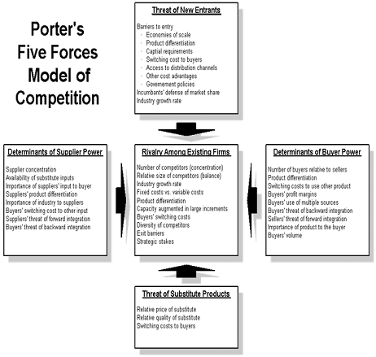
The five forces are:

Slide 12
The five forces are:
Bargaining Power of Buyers: This includes an evaluation of how easy it is for buyers to drive prices down. This is driven by the number of buyers in the market, the importance of each individual buyer to the organization and the cost to the buyer of switching from one supplier to another. | Bargaining Power of Suppliers: This includes an evaluation of how easy it is for suppliers to drive up prices. This is driven by the number of suppliers of each essential input, the uniqueness of their product or service, the relative size and strength of the supplier and the cost of switching from one supplier to another. | Rivalry Among Existing Firms: This includes an evaluation of the competitiveness of the various firms existing in a particular market. This is dependent on the pace of industry growth, concentration and balance of competition, differentiation of products by the various firms, switching costs, economies of scale, fixed variable costs, exit barriers, etc.

Slide 13
Threats of New Entrants: Markets that are profitable attract new entrants, eroding profitability. Profitability will decrease to a competitive rate unless incumbents have strong and long-lasting barriers to entry, such as patents, economies of scale, capital requirements, or government laws. | Threats of Substitutes: Where close substitute products exist in a market, it increases the likelihood of customers switching to alternatives in response to price increases. This reduces both the power of suppliers and the attractiveness of the market.

Slide 14
4. Value Chain Analysis:
The term value chain refers to the various business activities and processes involved in creating a product or performing a service. Taking inventory of the operations that make up a company's value chain will give the company a better understanding of what goes into each transaction. Thereby, positioning it to share more value with customers while capturing a larger share by optimising the value provided at each step in the chain.
Value chain analysis enables a firm to evaluate each of the activities in a company’s value chain in order to find opportunities for improvement. In order to conduct value chain analysis, the first step is to separate a company’s operations into primary and secondary activities:

Slide 15
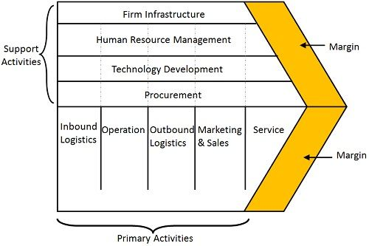

Slide 16
Primary Activities: In general, the primary activities include the following activities:
  Inbound logistics: Activities related to receiving, warehousing, and inventory management of source materials and components
  Operations: Activities related to turning raw materials and components into a finished product
  Outbound logistics: Activities related to distribution, including packaging, sorting, and shipping
  Marketing and sales: Activities related to the marketing and sale of a product or service, including promotion, advertising, and pricing strategy
  After-sales services: Activities that take place after a sale has been finalized, including installation, training, quality assurance, repair, and customer service.

Slide 17
Secondary activities: For a firm, the secondary activities include the following activities:
  Procurement: Activities related to the sourcing of raw materials, components, equipment, and services
  Technological development: Activities related to research and development, including product design, market research, and process development
  Human resources management: Activities related to the recruitment, hiring, training, development, retention, and compensation of employees.
  Infrastructure: Activities related to the company’s overhead and management, including financing and planning
Usually, increasing the performance of one of the four secondary activities can benefit at least one of the primary activities.
Once the primary and secondary activities involved in the creation of the product/ service are analysed, the next steps are to determine the value that each activity adds to the process along with the costs involved and to analyse the costs and value in order to achieve competitive advantage in either the cost reduction or the product differentiation metrics.

Slide 18
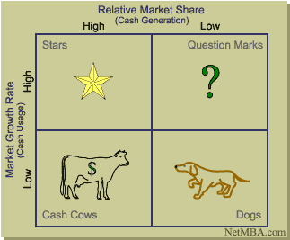
BGC matrix

Slide 19
Introduction
The growth share matrix was created in 1968 by BCG’s founder, Bruce Henderson. It was published in one of BCG’s short, provocative essays, called Perspectives. At the height of its success, the growth share matrix was used by about half of all Fortune 500 companies; today, it is still central in business school teachings on business strategy.

Slide 20
The matrix reveals two factors that companies should consider when deciding where to invest—company competitiveness, and market attractiveness—with relative market share and growth rate as the underlying drivers of these factors.
Each of the four quadrants represents a specific combination of relative market share, and growth:
Low Growth, High Share. Companies should milk these “cash cows” for cash to reinvest.
High Growth, High Share. Companies should significantly invest in these “stars” as they have high future potential.
High Growth, Low Share. Companies should invest in or discard these “question marks,” depending on their chances of becoming stars.
Low Share, Low Growth. Companies should liquidate, divest, or reposition these “pets.”
As can be seen, product value depends entirely on whether or no

Slide 21
STAR
Stars- Stars represent business units having large market share in a fast growing industry. They may generate cash but because of fast growing market, stars require huge investments to maintain their lead. Net cash flow is usually modest. SBU’s located in this cell are attractive as they are located in a robust industry and these business units are highly competitive in the industry. If successful, a star will become a cash cow when the industry matures.

Slide 22
Cash Cows-
Cash Cows represents business units having a large market share in a mature, slow growing industry. Cash cows require little investment and generate cash that can be utilized for investment in other business units. These SBU’s are the corporation’s key source of cash, and are specifically the core business. They are the base of an organization. These businesses usually follow stability strategies. When cash cows loose their appeal and move towards deterioration, then a retrenchment policy may be pursued.

Slide 23
Question Marks-
Question marks represent business units having low relative market share and located in a high growth industry. They require huge amount of cash to maintain or gain market share. They require attention to determine if the venture can be viable. Question marks are generally new goods and services which have a good commercial prospective. There is no specific strategy which can be adopted. If the firm thinks it has dominant market share, then it can adopt expansion strategy, else retrenchment strategy can be adopted. Most businesses start as question marks as the company tries to enter a high growth market in which there is already a market-share. If ignored, then question marks may become dogs, while if huge investment is made, then they have potential of becoming stars.

Slide 24
Question Marks
Dogs represent businesses having weak market shares in low-growth markets. They neither generate cash nor require huge amount of cash. Due to low market share, these business units face cost disadvantages. Generally retrenchment strategies are adopted because these firms can gain market share only at the expense of competitor’s/rival firms. These business firms have weak market share because of high costs, poor quality, ineffective marketing, etc. Unless a dog has some other strategic aim, it should be liquidated if there is fewer prospects for it to gain market share. Number of dogs should be avoided and minimized in an organization.

Slide 25
Portfolio analysis
Portfolio analysis in strategic management involves analyzing every aspect of product mix to identify and evaluate all products or service groups offered by the company on the market, to prepare the detailed strategies for each part of the product mix to improve the growth rate.

Slide 26
Reasons For Portfolio Analysis
1. Analysis
The organization’s first reason to conduct a portfolio analysis in strategic management is to determine every product mix’s current position and determine which SBUs (strategic business unit) need more or less investment. Management needs to create the organization’s entire portfolio to analyze the present opportunities and threats to the market and the product.
2. Formulate Growth Strategy
Another aspect that management wants to formulate from the portfolio analysis in strategic management is the growth strategy. According to other products and markets, they develop a different strategy according to their potential threats and opportunities. Portfolio analysis in strategic management helps in laying down the strategy of expansion as well
3. To Take Decisions Regarding Product Retention
Another reason for corporate portfolio analysis in strategic management is to determine the life of the product i:e, to determine which product should be retained longer and which product should be removed from the product line.
These are the three primary and basic reasons for the portfolio analysis in strategic management.

Slide 27
Situational analysis
A situation analysis is a detailed examination of a company’s market presence based on internal and external factors. It examines a business’s current and potential customers and how they respond to the company’s products and services. A situation analysis also explores a firm’s capabilities and how the current business climate impacts the company.
An analysis can forecast what results a company can expect—based on the decisions made—so it can adjust its strategies to meet its goals. A situational analysis can reveal many important details about a business such as:

Slide 28
Importance of situation analysis,
Helps define the nature and scope of a problem
Helps identify the current strategies and activities in place to overcome the problem
Helps understand the opinions and experiences of stakeholders
Helps give a comprehensive view of the current situation of the organization
Helps detect the gaps between the current state and desired state
Provides information necessary to create a plan to get to reach the goals
Helps identify the best courses of action to take during the project
Helps make sure that efforts and actions are not repeated and wasted unnecessarily

Slide 29
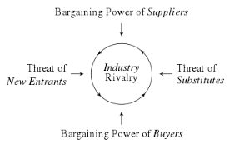
Michael porters Five force model

