Slide 1
Roles and Types of Managers

Slide 2
Management Roles
Role
  A set of expectations of how one will behave in a given situation.
Management Role Categories (Mintzberg)
  Interpersonal
    Figurehead, leader, and liaison
  Informational
    Monitor, disseminator, and spokesperson
  Decisional
    Entrepreneur, disturbance handler, resource allocator, and negotiator

Slide 3
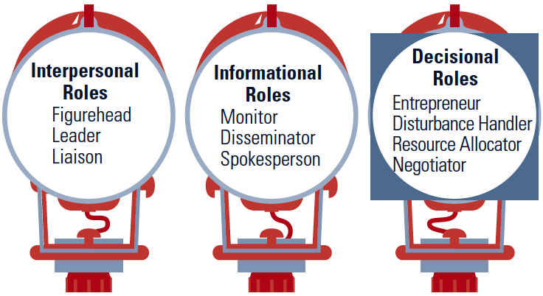
Ten Roles Managers Play
Managers play various roles as necessary while performing their management functions so as to achieve organizational objectives.

Slide 4
A. Interpersonal Roles arise directly from the formal authority the manager has and involve interpersonal relationships.
1. Figurehead role
The manager performs ceremonial and symbolic duties by virtue of his position. They include: receiving dignitaries, attending parties, visiting the sick employees, etc.
2. Leadership role
This role is particularly performed by heads of units or departments. As heads managers are responsible for the work of people in that unit. As a leader he gives directions, appraises performance, correct mistakes, disciplines staff, motivates subordinates, determines rewards and punishments, etc.
3. Liaison role
The manager ensures contacts with other units and outside agencies on behalf of own unit. He works more as a public relations officer.

Slide 5
B. Informational Roles. Due to his status and contacts the manager gets to know a lot of information which may not be available to his subordinates. This information he uses in a variety of ways for the effective functioning of his unit.
4. Monitor
As a monitor of information, the manager scans his environment for information. As a monitor of information he is continuously keeping his ears open for all sources. Typically, this is done by reading papers and talking with others.
5. Disseminator
After having acquired information, the manager also passes this information relatively to his subordinates, superiors and colleagues.
6. Spokesman role
The manager represents his unit and its problems in different forums. As a spokesman, the manager presents the problem of his unit to others, and presents information to others who control his unit and so on.

Slide 6
C. Decisional Roles. By virtue of the position and authority vested in him, a manager is continuously making decisions dealing with the unit's strategy, allocation of resources, solving problems, etc.
7. Entrepreneurial role
The manager seeks to respond to the changing conditions of environment. He is constantly looking for new ideas and initiating development projects.
8. Disturbance handler
He responds to pressures and crisis situations.
9. Resource allocater
This role involves the allocation of resources: human, physical, financial and other forms of resources to get things done. Allocation of his own time and powers are important dimension
10. Negotiator
The manager is carrying on negotiations with external as well as internal agents. The negotiator role is very important as the manager's capability to negotiate determines the unit's performance.

Slide 7
Differences Among Managers
The Three Levels of Management
  Top managers
    CEO, president, or vice president
  Middle managers (Functional Level)
    Sales manager, branch manager, or department head
  First-line managers
    Crew leader, supervisor, head nurse, or office manager
  Individual Contributors (ICs)
    Non-management operative employees
      Workers in the organization who are supervised by first-line managers.
    Professionals/Specialists/Technicians (Knowledge Workers)

Slide 8
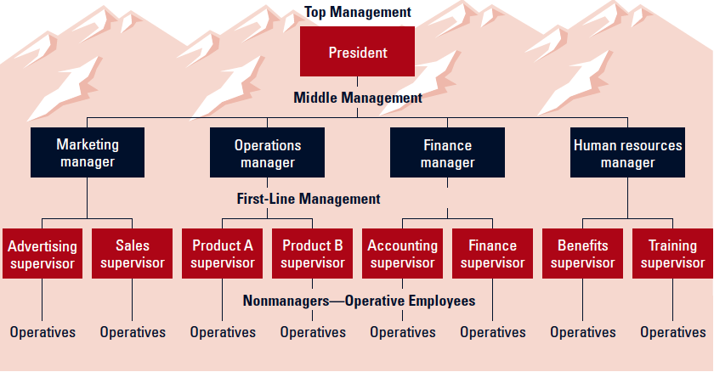
Management Levels and Functional Areas
SOME ORGANIZATIONS “FLIP” THIS CHART UPSIDE DOWN
INDIVIDUAL CONTRIBUTORS OFTEN REPORT ANYWHERE

Slide 9
Types of Managers
General Managers
  Supervise the activities of several departments.
Functional Managers
  Supervise the activities of related tasks.
  Common functional areas:
    Marketing/Sales/Product Development
    Operations/Production/Services Delivery
    Finance/Accounting
    Human Resources/personnel management
    Infrastructure (IT, Real Estate, Legal)
Project Managers
  Coordinate employees across several functional departments to accomplish a specific task.

Slide 10
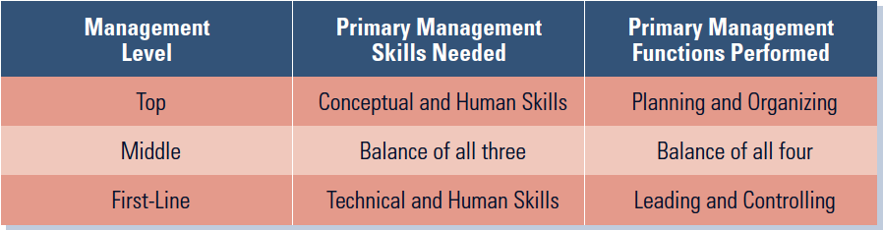
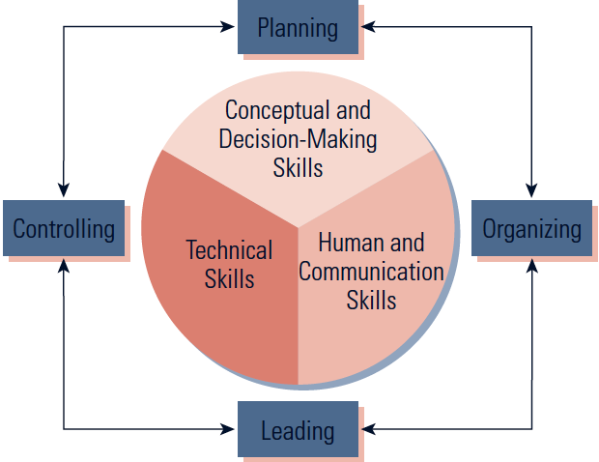
Management Skills and Functions
Differences among management levels in skill needed and the functions performed:

