Slide 1
ESSENTIAL AND NON ESSENTIAL AMINO ACIDS
DEFINATION:-
AMINONACIDS
Amino Acids are the organic compounds that combine to form proteins, hence they are referred to as the building components of proteins. These biomolecules are involved in several biological and chemical functions in the human body and are the necessary ingredients for the growth and development of human beings. There are about 300 amino acids that occur in nature.

Slide 2
ESSENTIAL AMINO ACIDS
DEFINATION:-
Amino acids which cannot be synthesised in the body and must be taken in diet are called essential amino acids e.g., valine, leucine, phenylalanine etc.

Slide 3
Essential amino acids are the amino acids which have to be taken in through diet as they “CAN NOT” be produced by the body
9 amino acids out of 20 are thought to be essential
As the definition implies, essential amino acids have to be acquired through food – such as soy, quinoa, egg, chicken, meat or vegetable protein

Slide 4
Serves to build and repair muscle tissues. Also, it forms precursor molecules for the formation of neurotransmitters in the brain
Highly probably as these amino acids are acquired through food

Slide 5
Your body needs 20 different amino acids to grow and function properly. While all 20 of these are important for your health, only 9 are classified as essential (1Trusted Source).
These are histidine, isoleucine, leucine, lysine, methionine, phenylalanine, threonine, tryptophan, and valine.

Slide 6
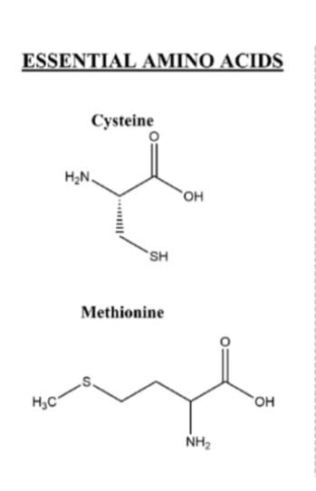

Slide 7
NON ESSENTIAL AMINO ACID:-
DEFINATION :-
NON ESSENTIAL AMINO ACIDS MEANS THAT OUR BODIES CAN
PRODUCE THE AMINO ACIDSEVEN IF WE DO NOT GET IT
FROM FOOD WE EAT .

Slide 8
Nonessential Amino Acids
Nonessential amino acids need not be taken in through diet as they can be produced by the body
11 of the 20 amino acids are non-essential
Are produced within the body from other amino acids and other components

Slide 9
Removal of toxins, integral in the synthesis of RBC and WBC, promotes brain function and many more.
Probability of deficiency is rare, but can still occur due to starvation or illness.
Amino acids which can be synthesised in the body are known as non-essential amino acids. E.g, glycine, alanine glutamic acid etc.

Slide 10
NON ESSENTIAL AMINO ACIDS INCLUDES
ALANINE ,ARGININE,ASPARAGINE,ASPARTIC ACIDS
CYSTEINE,GLUTAMIC ACIF,GLUTAMINE
GLYCINE,PROLINE,SERINE,TYROSINE.

Slide 11
