Slide 1
Marchantia

Slide 2
T.S. Thallus

Slide 3
Gemma cup

Slide 4
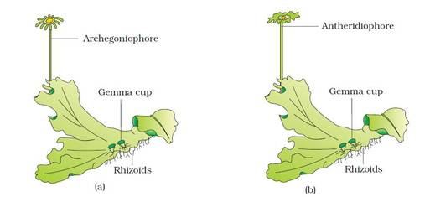
Anthrediophore and Archegoniophore

Slide 5
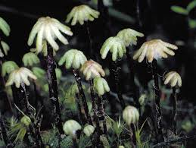
Archegoniophore

Slide 6
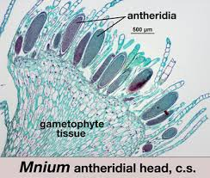
Anthrediophore V. S.

Slide 7
Archegoniophore V. S.

Slide 8
sporophyte

Slide 9
Spores and elaters

Slide 10
ANTHOCEROS

Slide 11
Gametophyte

Slide 12
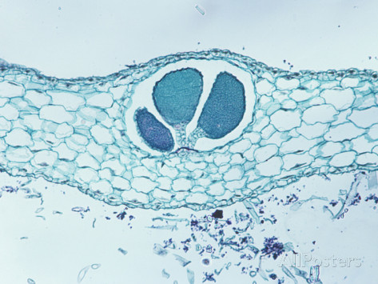
V. S. Of Gametophyte showing anthredia

Slide 13
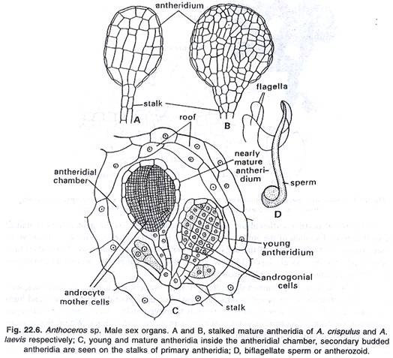

Slide 14
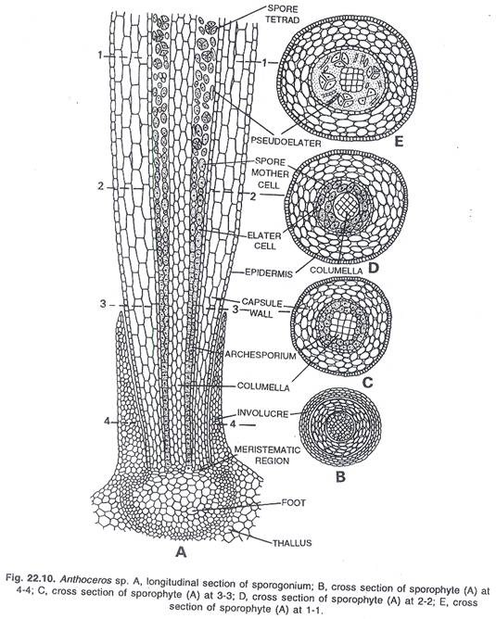
V. S. of Sporophyte

